Slide 1

PEC-3
BUDGET OVERRUNS IN INTERIOR DESIGN PROJECT: CAUSE AND SOLUTION
DHYAN MUTHANNA NA PES1UG22BC100
JEEVITHA R ASST. PROF
ADITI JAIN MODSCALE

Slide 2
Table of contents
BUDGET OVERRUNS IN INTERIOR DESIGN PROJECT: CAUSE AND SOLUTION
Sl. No. | Contents of Presentation
1. | Data Analysis and Planning
2. | Conclusion And Recommendations

Slide 3
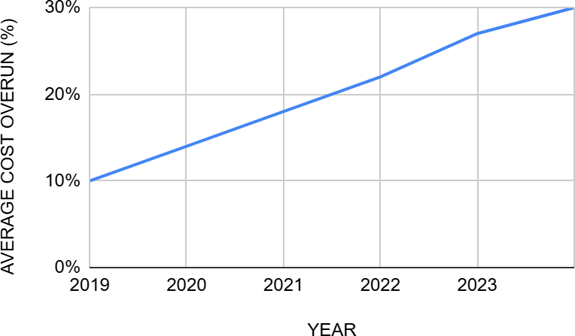
BUDGET OVERRUNS IN INTERIOR DESIGN PROJECT: CAUSE AND SOLUTION
Data Analysis And Planning
LINE GRAPH
TREND FOR AVERAGE PROJECT COST OVERRUNS (2019-2024)
Over the past five years, interior design project cost overruns have increased from 10% to 30% due to factors like rising material costs, labor inefficiencies, and scope changes. External factors include inflation, supply chain disruptions, and industry-specific factors like demand for custom finishes and underestimation. Reports from interior design and construction industries show similar trends.
YEAR | AVERAGE COST OVERUN (%)
2019 | 10%
2020 | 14%
2021 | 18%
2022 | 22%
2023 | 27%
2024 | 30%

Slide 4
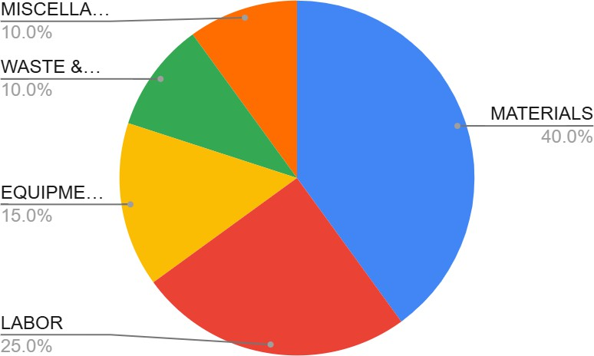
BUDGET OVERRUNS IN INTERIOR DESIGN PROJECT: CAUSE AND SOLUTION
Data Analysis And Planning
PIE CHART
COST DISTRIBUTION IN INTERIOR DESIGN PEOJECTS
The cost distribution in interior design projects includes materials (40%), labor (25%), equipment (15%), waste and rework (10%), and miscellaneous (10%). Sustainable materials tend to cost 20-30% more than standard options, while skilled labor costs are rising. Efficient budgeting practices can reduce waste and rework costs, while sustainable materials may save money in the long term.
COST COMPONENT | PERCENTAGE(%)
MATERIALS | 40%
LABOR | 25%
EQUIPMENT/ TOOLS | 15%
WASTE & REWORK | 10%
MISCELLANEOUS | 10%

Slide 5
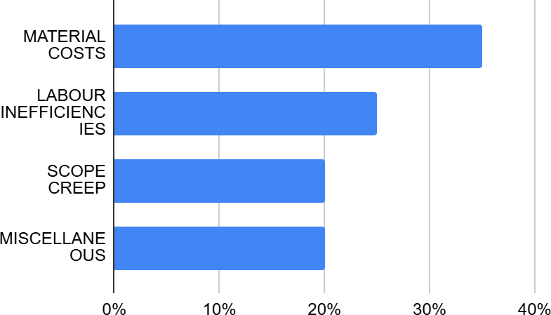
Data Analysis And Planning
BUDGET OVERRUNS IN INTERIOR DESIGN PROJECT: CAUSE AND SOLUTION
BAR GRAPH
CAUSES OF BUDGET OVERRUNS IN INTERIOR DESIGN PROJECTS
The study reveals that 35% of budget overruns in interior design projects are caused by material costs, labor inefficiencies, scope creep, and miscellaneous factors. To address these issues, it suggests using predictive modeling software and incorporating buffers into initial budgets.
CAUSES | PERCENTAGE CONTRIBUTION(%)
MATERIAL COSTS | 35%
LABOUR INEFFICIENCIES | 25%
SCOPE CREEP | 20%
MISCELLANEOUS | 20%

Slide 6
Data Analysis And Planning
BUDGET OVERRUNS IN INTERIOR DESIGN PROJECT: CAUSE AND SOLUTION
CHART
BUDGET CONTROL PROCESS IN INTERIOR DESIGN PROJECT
The process involves initial cost estimation, vendor selection, resource allocation, real-time monitoring, and milestone adjustments. It involves using detailed quotes, negotiating long-term contracts, scheduling labor and resources efficiently, using software tools, tracking expenses, and reassessing project scopes at major milestones to ensure budget compliance.
STEP NO. | BUDGET CONTROL STAGE | KEY ACTIONS
1 | INITIAL ESTIMATION | GATHER SUPPLIER QUOTES, INCLUDE CONTINGENCY BUDGET
2 | VENDOR SELECTION | COMPARE MULTIPLE VENDORS, NEGOTIATE DISCOUNTS
3 | RESOURCE ALLOCATION | EFFICIENT LABOUR AND MATERIAL MANAGEMENT
4 | REAL TIME MONITORING | TRACK EXPENSES REGULARLY, ADJUST BUDGETS
5 | MILESTONE ADJUSTMENTS | MODIFY BUDGETS AS NEEDED BASED ON PROJECT PROGRESS

Slide 7
Conclusion
BUDGET OVERRUNS IN INTERIOR DESIGN PROJECT: CAUSE AND SOLUTION
Conclusion
The rising trend of budget overruns in interior design projects, which has escalated from an average of 10% in 2019 to 30% in 2024, is primarily attributed to factors such as increasing material costs, labor inefficiencies, and scope changes. The cost distribution shows that materials constitute a significant portion of expenses, and the impact of external factors like inflation and supply chain disruptions cannot be overlooked. The effective management of these components is critical to achieve successful project delivery within budget.

Slide 8
BUDGET OVERRUNS IN INTERIOR DESIGN PROJECT: CAUSE AND SOLUTION
Recommendations
Recommendations
Utilize Predictive Modeling Software: Implementing advanced predictive modeling tools can help project managers anticipate budgetary issues and adjust forecasts accordingly. This proactive approach creates a more reliable budgeting framework.
Incorporate Budget Buffers: Including contingency funds in project budgets can help mitigate the impact of unexpected costs associated with material price increases and labor.
Enhance Vendor Management: Streamlining vendor selection processes and negotiating long-term contracts can lead to cost savings and help manage prices better over time.
Improve Resource Allocation: Efficient scheduling and management of labor and resources can significantly reduce project costs. This also includes training staff to optimize resource use and efficiency.
Real-Time Monitoring: Implementing real-time tracking mechanisms for expenses allows for quick identification of budget deviations, enabling timely interventions to keep projects on track.
Address Scope Creep: Set clear project scopes and regularly reassess them at major milestones to prevent scope changes that can lead to significant cost overruns.

Slide 9
THANK YOU

